Slide 1

Front End Engineering-I Project
Team Details:
Rudransh Verma(Group Leader)
Pulkit Bajaj
Akshay Pratap
Faculty Coordinator: Dr.Vinay Gautam
:
Chitkara University Institute of Engineering and Technology,
Chitkara University, Punjab

Slide 2
Table of Contents
Introduction
Problem Statement
Technical Details
Key Features
Project Highlights
Bonus Feature
Conclusion
References/Links used

Slide 3
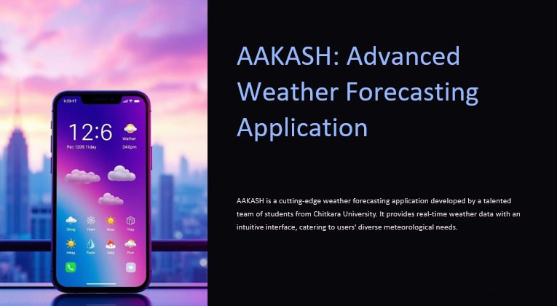
Introduction :
AAKASH -Weather Forecasting App
Team Members:
Rudransh Verma(Team Leader)
Pulkit Bajaj
Akshay Pratap
Overview:
This webpage provides hourly and weekly weather details for different location such as temperature , rainfall, wind speed. It also lists recent places visited.

Slide 4
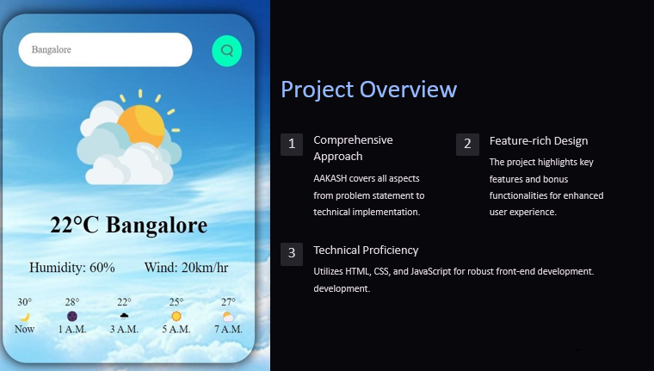
Overview
AAKASH
This website aims to provide users with real-time, hourly and weekly weather information for various locations, as well as a list of recent places visited. This app uses user’s location or search history to fetch real-time weather data. This helps users plan their activities based on weather conditions.

Slide 5


Technical Details
HTML
CSS

Slide 6
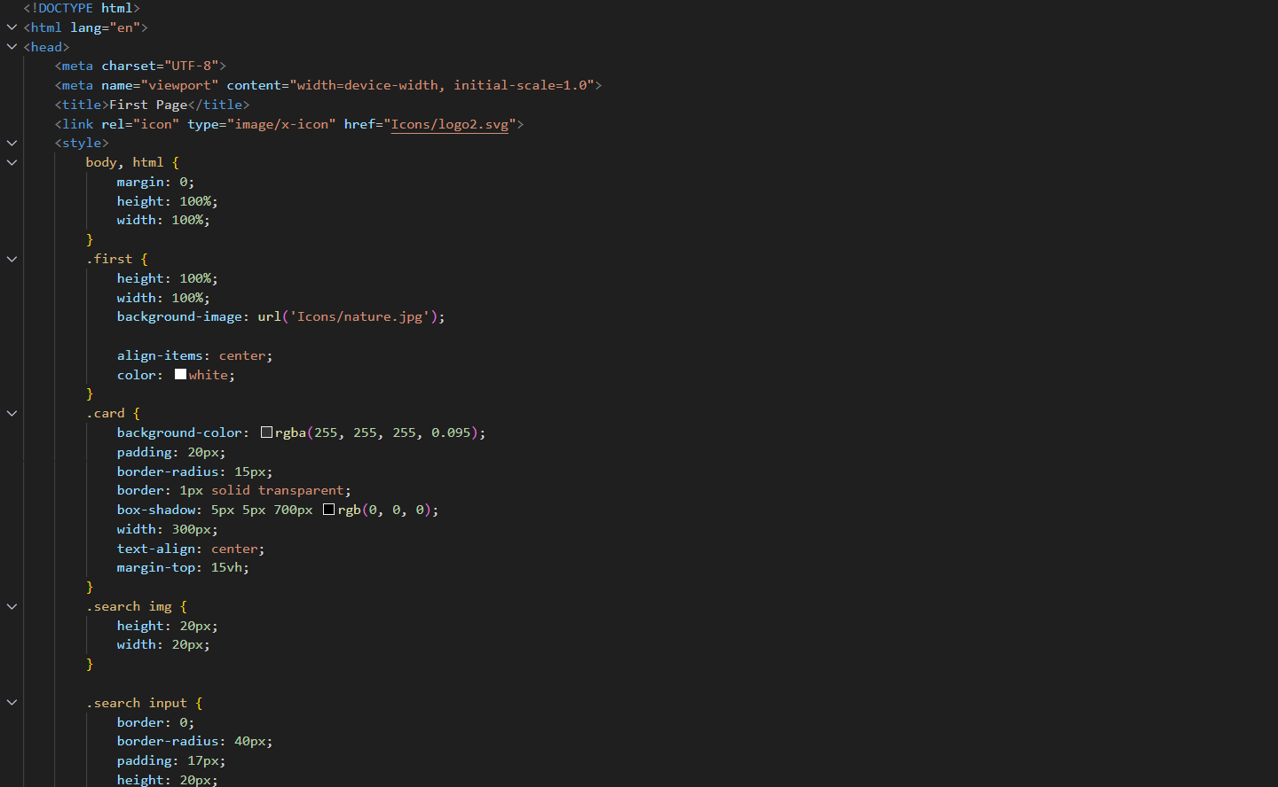
CODE SNIPPETS

Slide 7
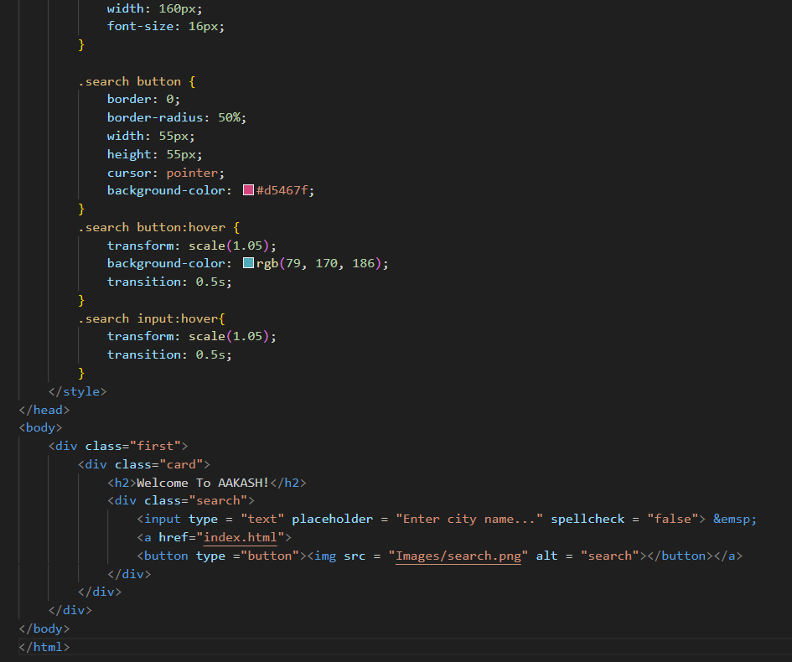

Slide 8
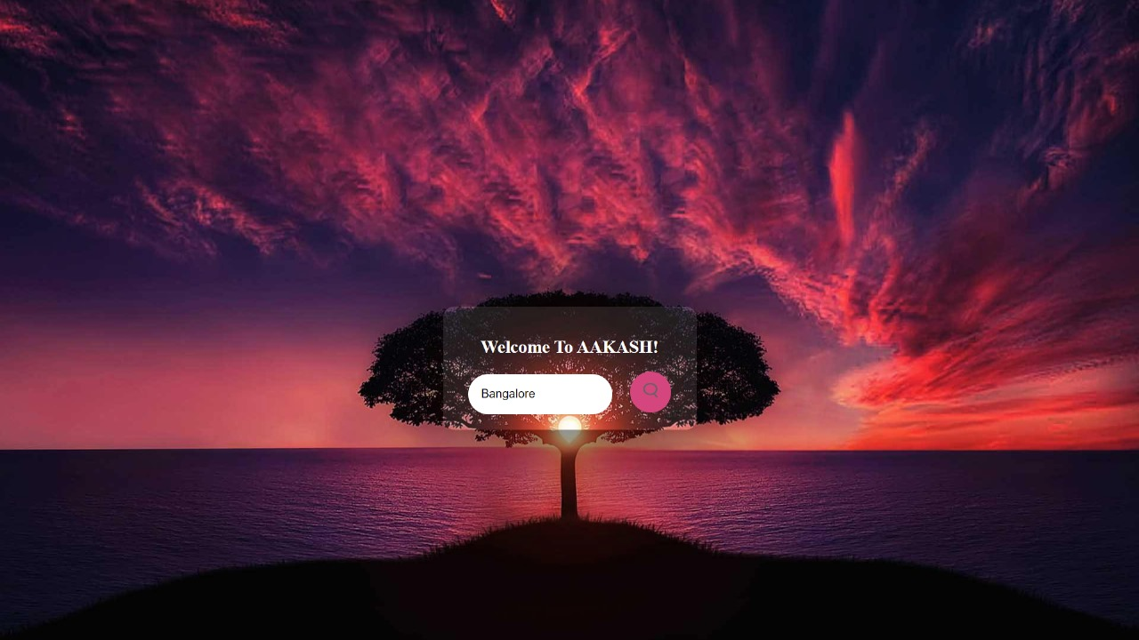

Slide 9
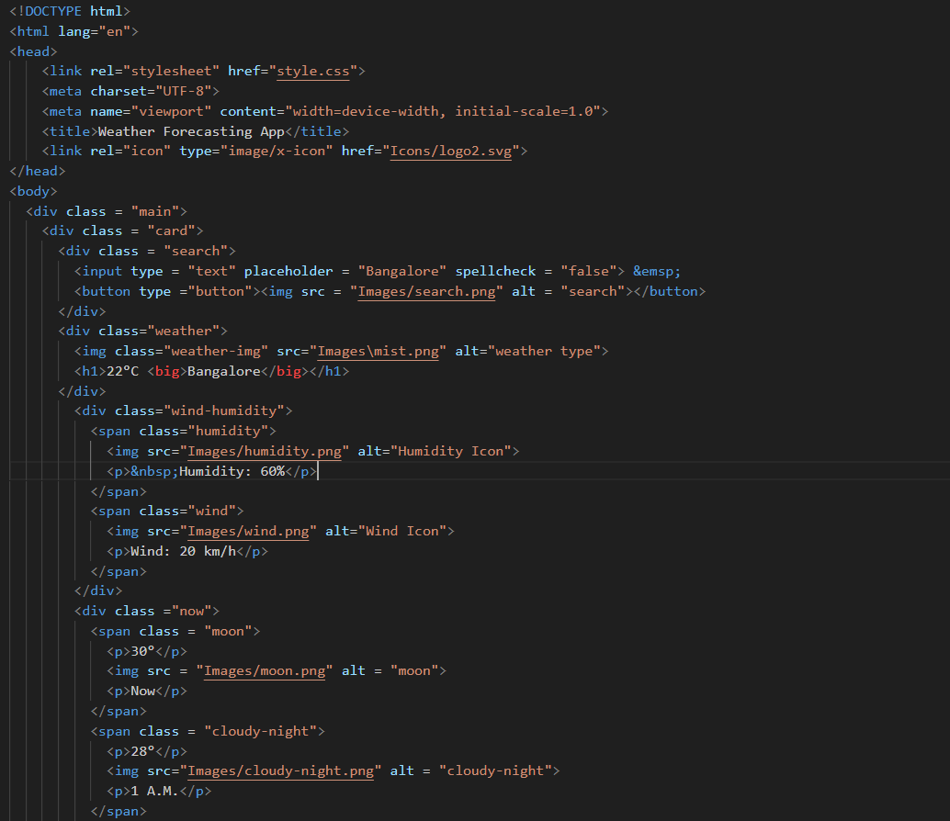
HTML CODE

Slide 10
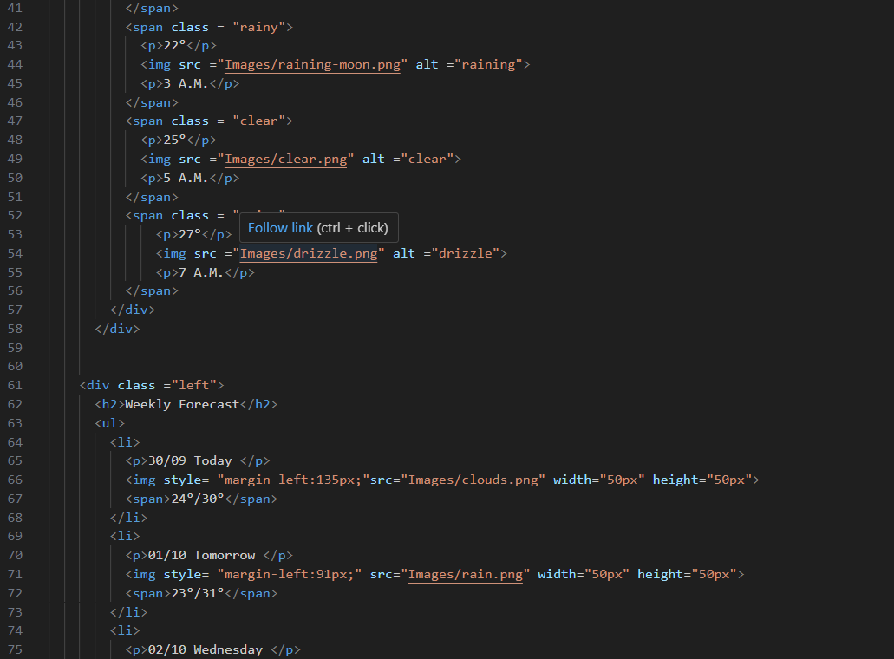

Slide 11
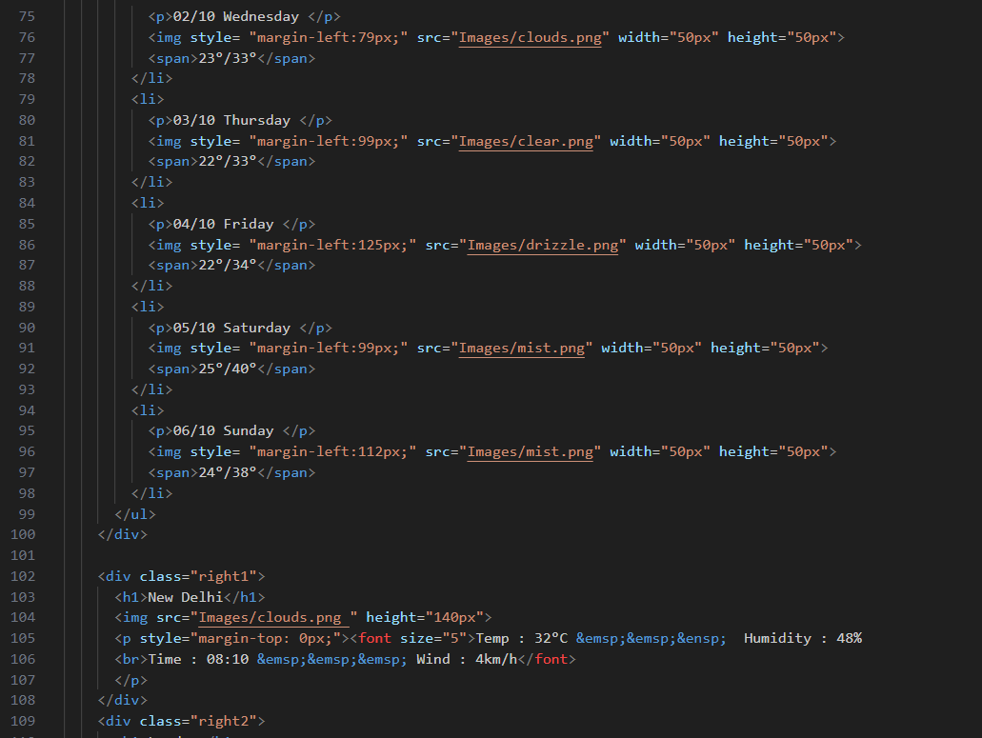

Slide 12
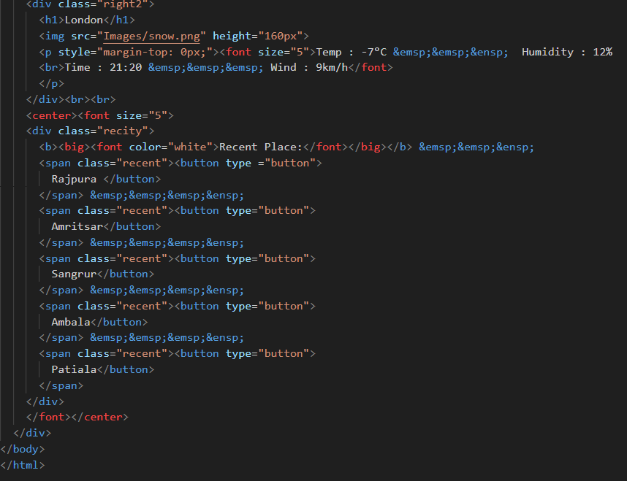

Slide 13
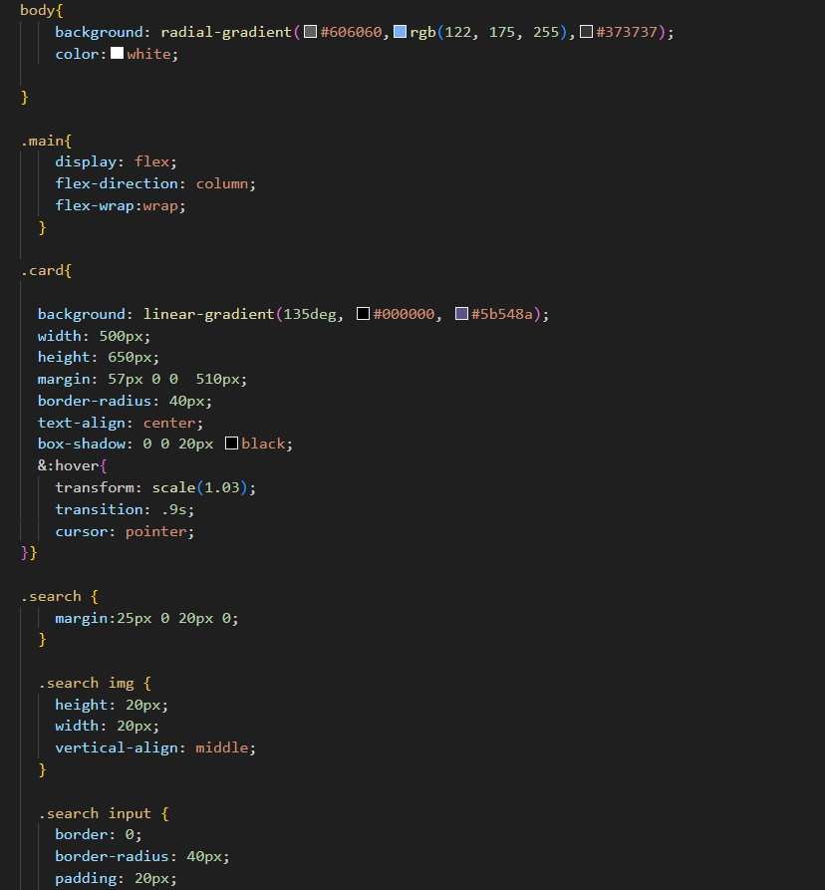
CSS

Slide 14
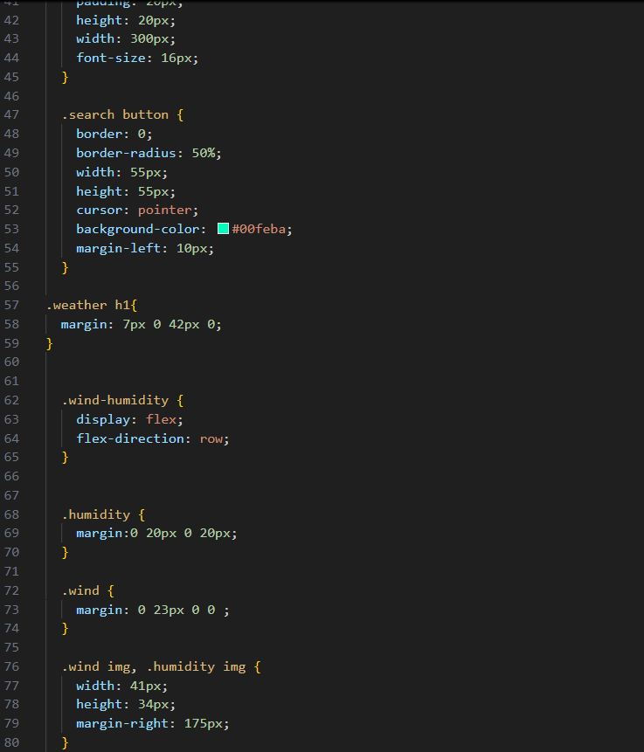

Slide 15
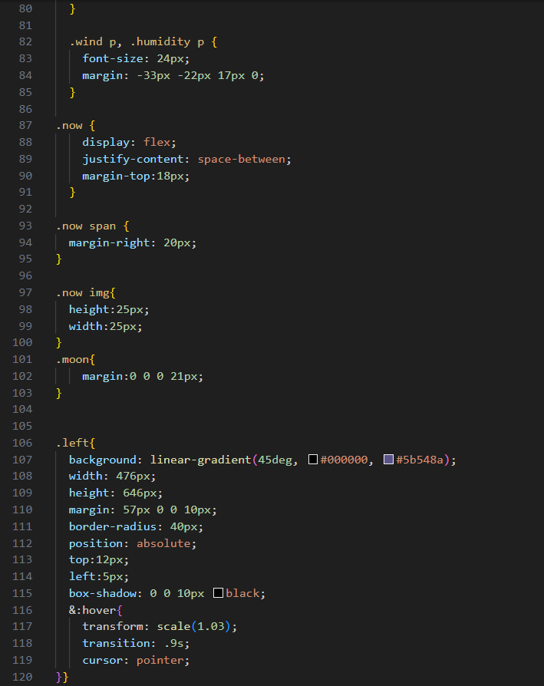

Slide 16
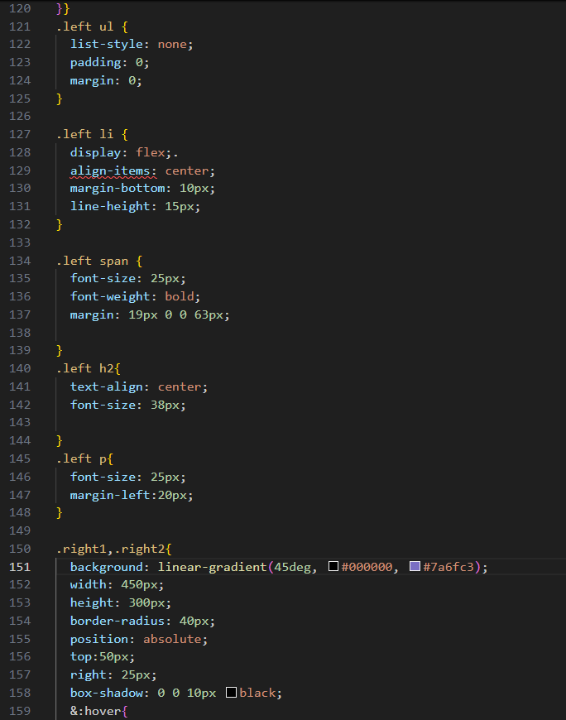

Slide 17
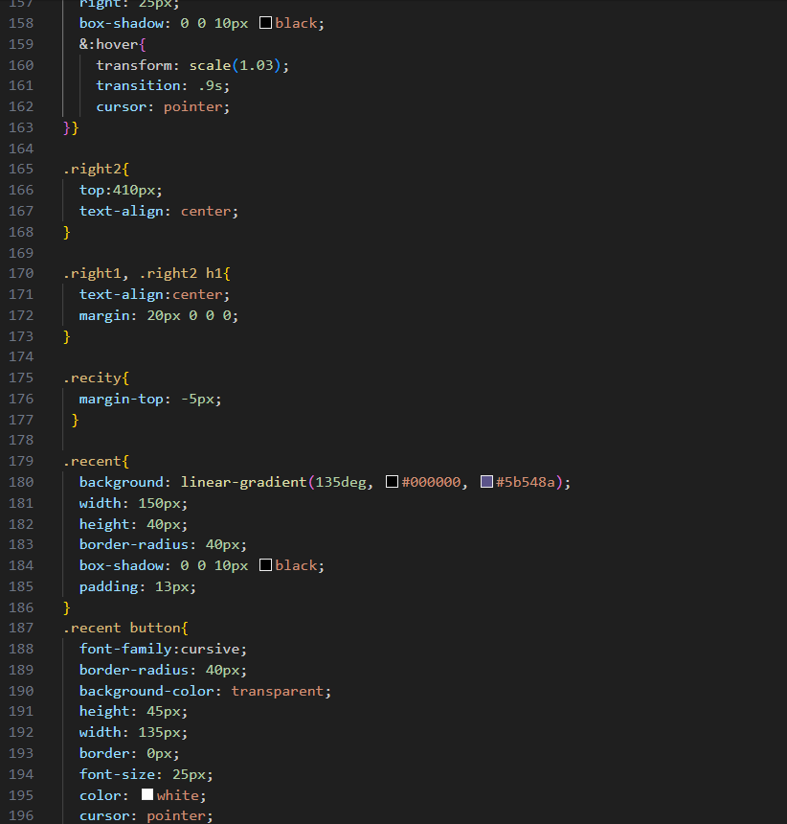

Slide 18
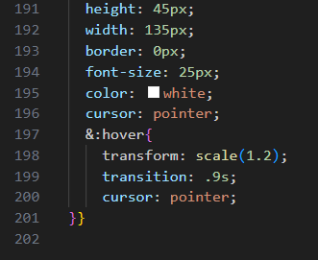

Slide 19
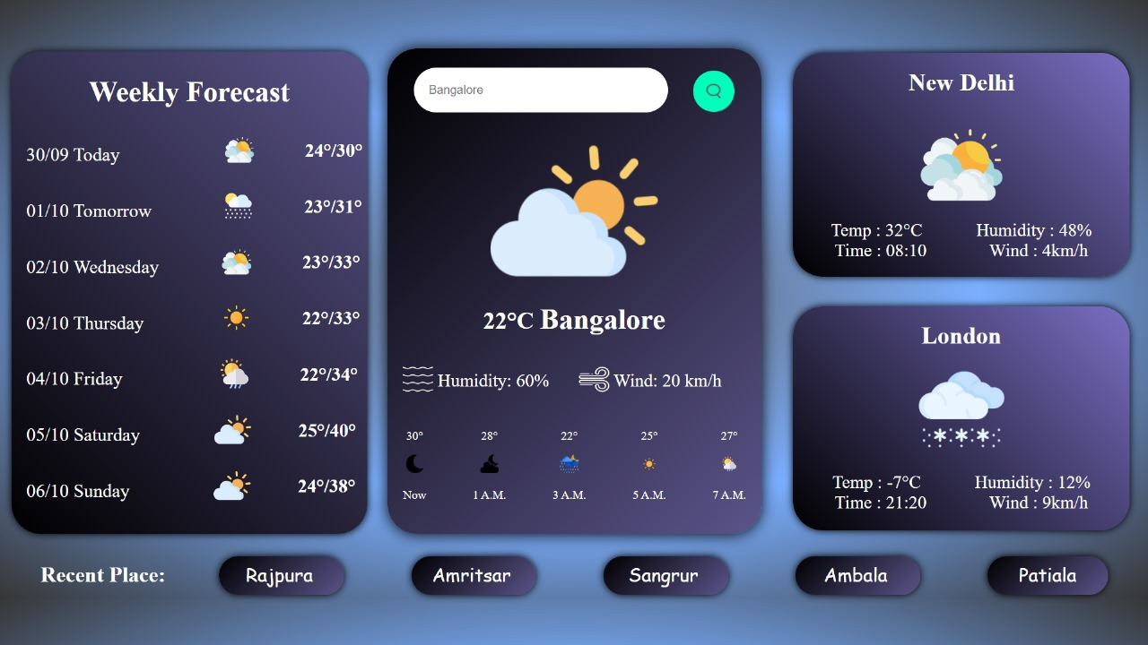
OUTPUT

Slide 20
Key Features
First Page: The page where you search for a specific location’s weather and it redirect’s you to the main page giving the weather details of that location.
Main Page: This page showcases temperature, rainfall, humidity, wind speed etc. information of various places and recent places.

Slide 21
Bonus Feature
Our website enables user to pin any two cities weather-data as per his/her choice.
User can also access recent cities based on their location and search history.
User can see the real-time data and also see current-time of different locations.

Slide 22
Conclusion
In conclusion, this website provides current weather details for different cities along with a brief forecast for over the next few days. It also lists recent places visited. The times provided suggest that the data is updated for each location at different points throughout the day.

Slide 23
References/Links used
Sources:
VS Code
Freepik website for images
Reference:
CodeWithHarry
GreatStack

Slide 24


